Slide 1
Software Development Lifecycles Models

Slide 2
SDLC Models
A software development life cycle (SDLC) model is a conceptual framework describing all activities in a software development project from planning to maintenance. Most of the models are graphical models, which are drawn representations that employ agreed-upon symbols and conventions.

Slide 3
SDLC Models (cont’d)
SDLC Models
Predictive
e.g. waterfall, prototyping, RAD
Adaptive
e.g. Spiral, Agile, DDSDM
predictive SDLC assumes you can predict the complete workflow. It involves fully understanding the final product and determining the process for delivering it. In this form of project life cycle, you determine the cost, scope, and timeline in the early phases of the project.
Adaptive SDLC approaches have a mix of incremental and iterative development. It involves adding features incrementally and making changes and refinements according to feedback. In other words, the work can easily adapt to the changing requirements based on new feedback received from the client.

Slide 4
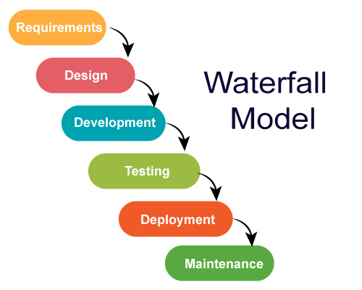
Waterfall Model
The Waterfall Model was first Process Model to be introduced. It is also referred to as a linear-sequential life cycle model. It is very simple to understand and use. In a waterfall model, each phase must be completed fully before the next phase can begin.
The main drawback of the waterfall model is the difficulty of accommodating change after the process is underway. In principle, a phase has to be complete before moving onto the next phase.

Slide 5
Advantages of Waterfall Model
Easy to understand, easy to use
Provides structure to inexperienced staff
Milestones are well understood
Sets requirements stability
Good for management control (plan, staff, track)
Works well when quality is more important than cost or schedule

Slide 6
Disadvantages of Waterfall Model
All requirements must be known upfront
Error can be fixed only during the phase
Can give a false impression of progress
It is not desirable for complex project where requirement changes frequently
Testing period comes quite late in the developmental process
Clients valuable feedback cannot be included with ongoing development phase
Small changes or errors that arise in the completed software may cause a lot of problems

Slide 7
When to use the Waterfall Model
Requirements are very well known
Product definition is stable
Technology is understood
New version of an existing product
Porting an existing product to a new platform.

Slide 8
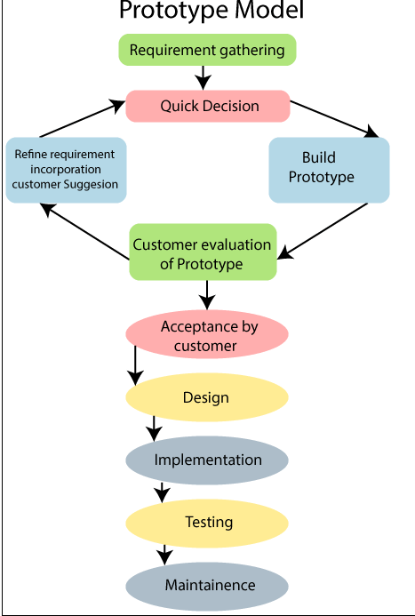
Prototype Model
The Prototyping Model is one of the most popularly used Software Development Life Cycle Models (SDLC models). This model is used when the customers do not know the exact project requirements beforehand. In this model, a prototype of the end product is first developed, tested and refined as per customer feedback repeatedly till a final acceptable prototype is achieved which forms the basis for developing the final product.

Slide 9
Types of Prototyping Models
Four types of Prototyping models are:
Rapid Throwaway prototypes
Evolutionary prototype
Incremental prototype
Extreme prototype

Slide 10
Types of Prototyping Models (cont’d)
Rapid Throwaway Prototype
Rapid throwaway is based on the preliminary requirement. It is quickly developed to show how the requirement will look visually. The customer’s feedback helps drives changes to the requirement, and the prototype is again created until the requirement is baselined.
In this method, a developed prototype will be discarded and will not be a part of the ultimately accepted prototype. This technique is useful for exploring ideas and getting instant feedback for customer requirements.

Slide 11
Types of Prototyping Models (cont’d)
Evolutionary Prototyping
Here, the prototype developed is incrementally refined based on customer’s feedback until it is finally accepted. It helps you to save time as well as effort. That’s because developing a prototype from scratch for every interaction of the process can sometimes be very frustrating.
This model is helpful for a project which uses a new technology that is not well understood. It is also used for a complex project where every functionality must be checked once. It is helpful when the requirement is not stable or not understood clearly at the initial stage.

Slide 12
Types of Prototyping Models (cont’d)
Incremental Prototyping
In incremental Prototyping, the final product is decimated into different small prototypes and developed individually. Eventually, the different prototypes are merged into a single product. This method is helpful to reduce the feedback time between the user and the application development team.

Slide 13
Types of Prototyping Models (cont’d)
Extreme Prototyping:
Extreme prototyping method is mostly used for web development. It is consists of three sequential phases.
Basic prototype with all the existing page is present in the HTML format.
You can simulate data process using a prototype services layer.
The services are implemented and integrated into the final prototype.

Slide 14
Advantages of Prototype model
Users are actively involved in the development
Since in this methodology a working model of the system is provided, the users get a better understanding of the system being developed.
Errors can be detected much earlier.
Quicker user feedback is available leading to better solutions.
Missing functionality can be identified easily

Slide 15
Disadvantages of Prototype model
Prototyping is a slow and time taking process.
The cost of developing a prototype is a total waste as the prototype is ultimately thrown away.
Leads to implementing and then repairing way of building systems.
Practically, this methodology may increase the complexity of the system as scope of the system may expand beyond original plans.

Slide 16
When to use the prototyping Model
Prototype model should be used when the desired system needs to have a lot of interaction with the end users.
Typically, online systems, web interfaces have a very high amount of interaction with end users, are best suited for Prototype model. It might take a while for a system to be built that allows ease of use and needs minimal training for the end user.
Prototyping ensures that the end users constantly work with the system and provide a feedback which is incorporated in the prototype to result in a useable system. They are excellent for designing good human computer interface systems.

Slide 17
RAD Model
RAD model is Rapid Application Development model. In RAD model the components or functions are developed in parallel as if they were mini projects. The developments are time boxed, delivered and then assembled into a working prototype.

Slide 18
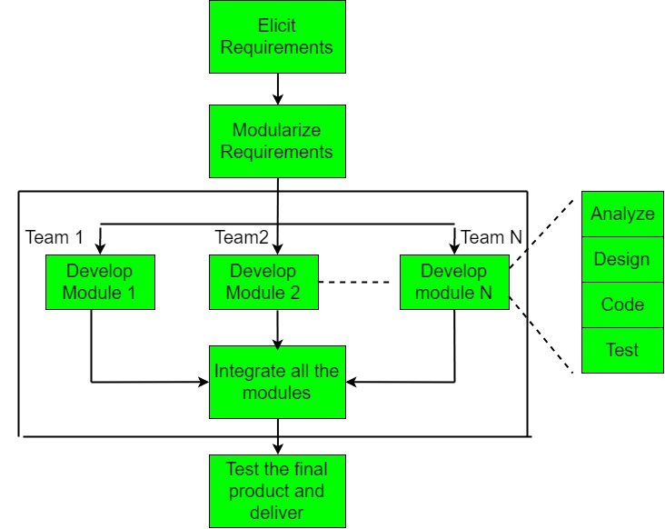
RAD Model

Slide 19
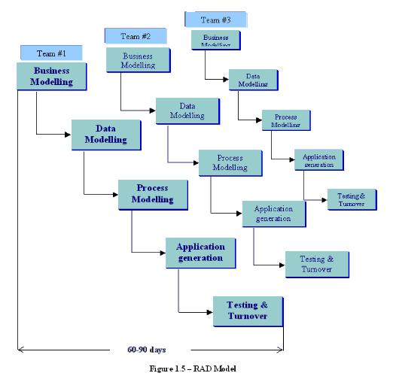

Slide 20
RAD Model (cont’d)
The phases in the rapid application development (RAD) model are:
Business modeling: The information flow is identified between various business functions.
Data modelling: Information gathered from business modeling is used to define data objects that are needed for the business.

Slide 21
RAD Model (cont’d)
Process modeling: Data objects defined in data modeling are converted to achieve the business information flow to achieve some specific business objective. Description are identified and created for CRUD of data objects.
Application generation: Automated tools are used to convert process models into code and the actual system. Testing and turnover: Test new components and all the interfaces.

Slide 22
Advantages of RAD Model
Reduced development time.
Increases reusability of components
Quick initial reviews occur
Encourages customer feedback
Integration from very beginning solves a lot of integration issues.

Slide 23
Disadvantages of RAD model:
Depends on strong team and individual performances for identifying business requirements.
Only system that can be modularized can be built using RAD
Requires highly skilled developers/designers.
High dependency on modeling skills
Inapplicable to cheaper projects as cost of modeling and automated code generation is very high.

Slide 24
When to use RAD model
RAD should be used when there is a need to create a system that can be modularized in 2-3 months of time.
It should be used if there’s high availability of designers for modeling and the budget is high enough to afford their cost along with the cost of automated code generating tools.
RAD SDLC model should be chosen only if resources with high business knowledge are available and there is a need to produce the system in a short span of time (2-3 months).

Slide 25
THE END
https://www.youtube.com/watch?v=Y_A0E1ToC_I
https://www.youtube.com/watch?v=YCpSveNDNL4
https://www.youtube.com/watch?v=i1VsjP02HwM

